Slide 1


British Airways SkyTrax Reviews Analysis
TASK 1 and 2

Slide 2
TASK 1

Slide 3
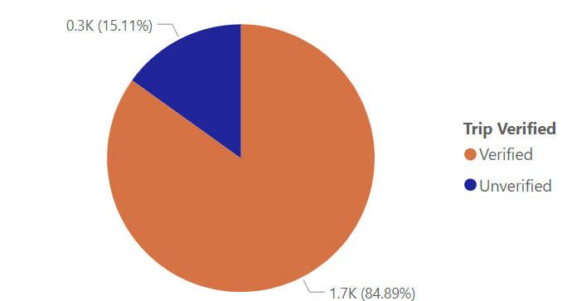
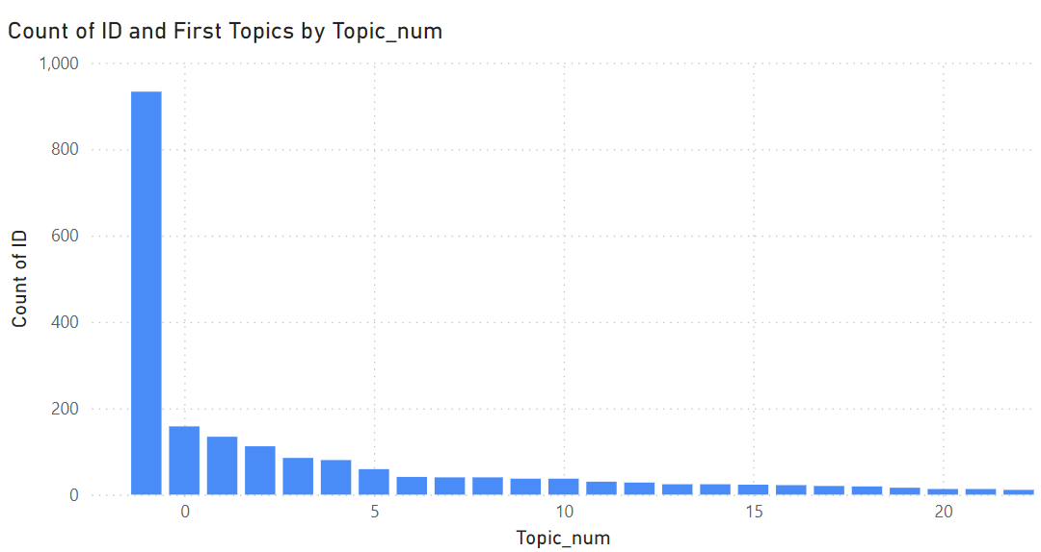
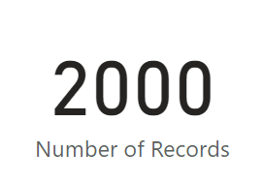
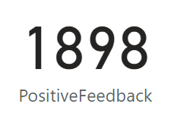
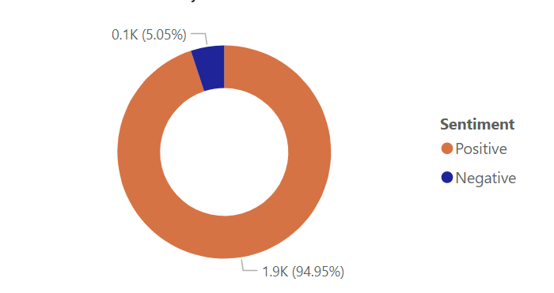
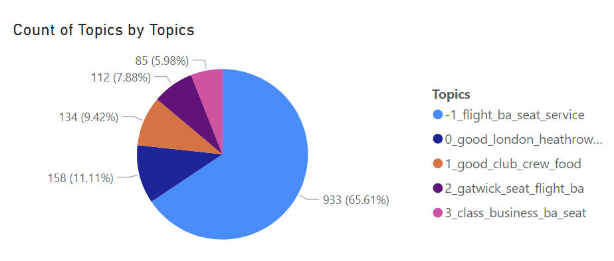
- This slide shows the sentiment analysis and topic modeling results performed on the reviews collected.
- Topic modeling was performed using the BERTopic model.
- Sentiment analysis was performed using NLTK sentiment analyzer.

Slide 4
TASK 2

Slide 5
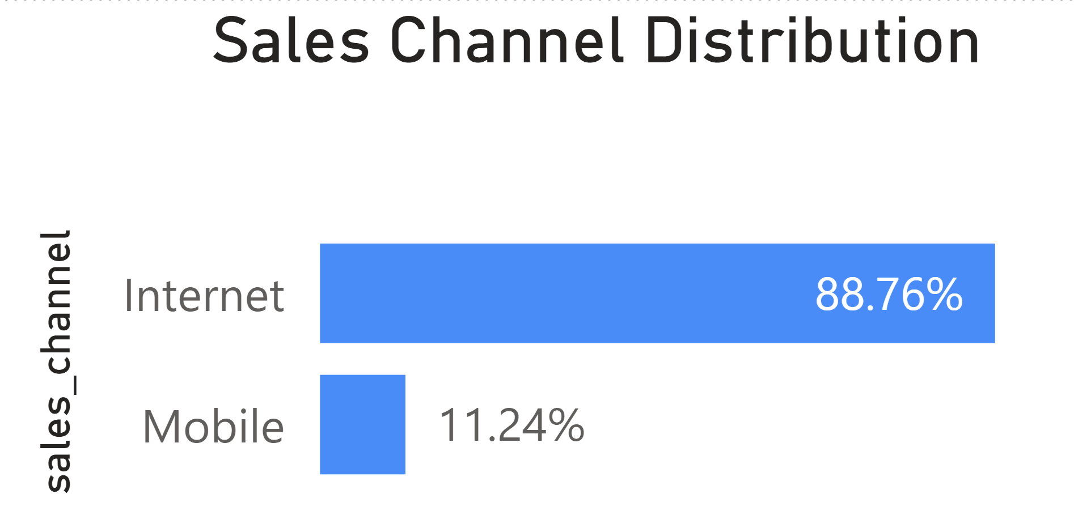
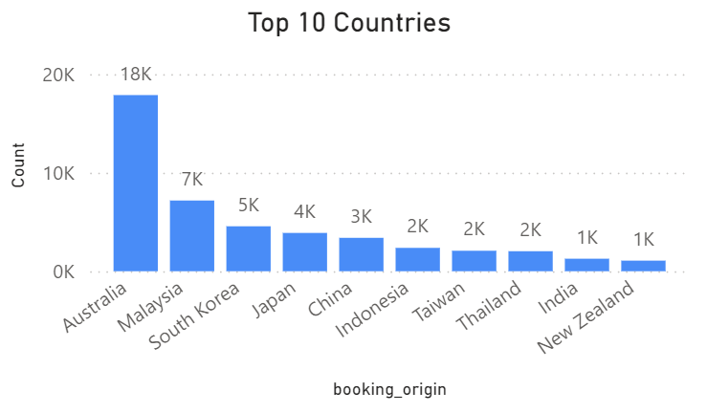
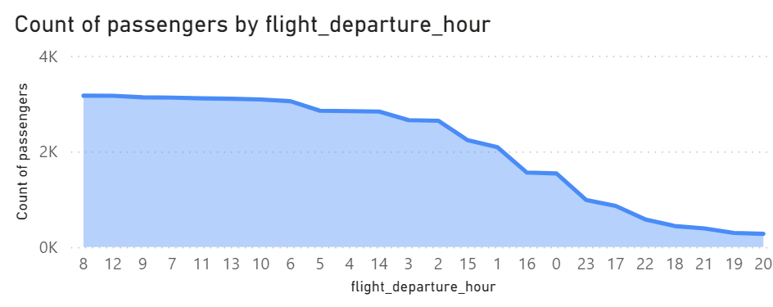
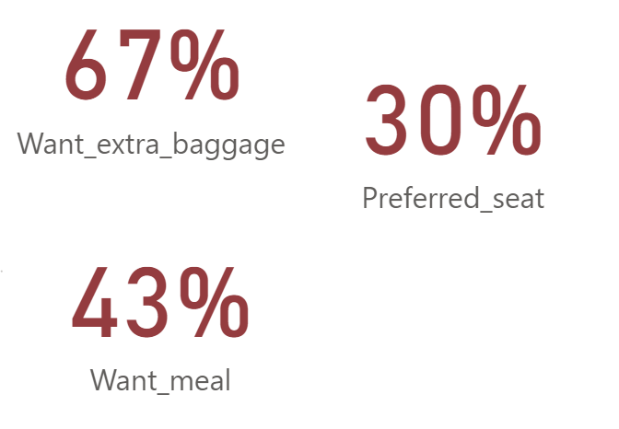
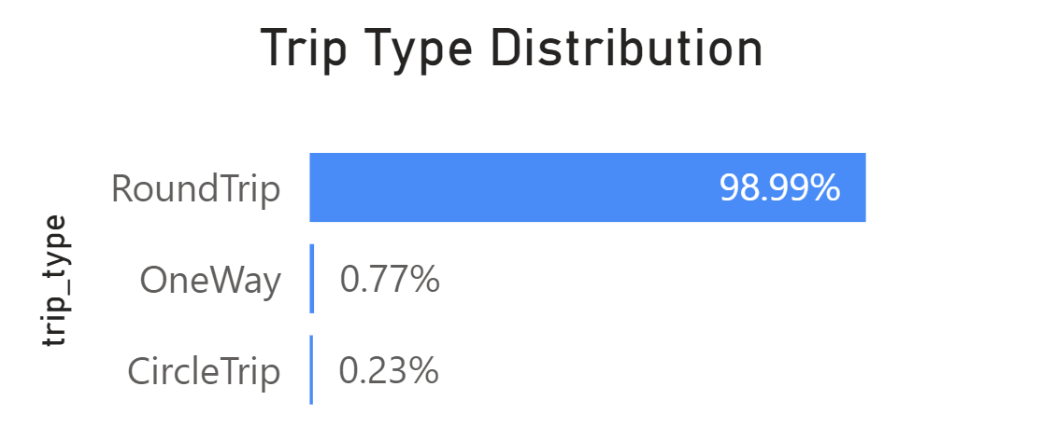
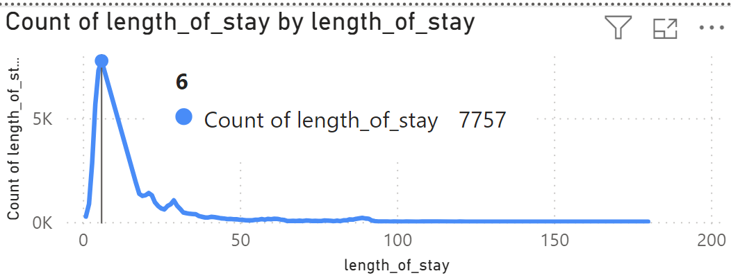
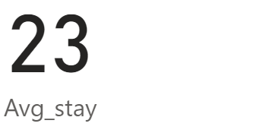
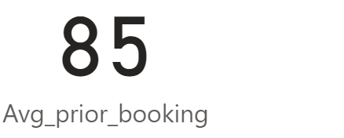
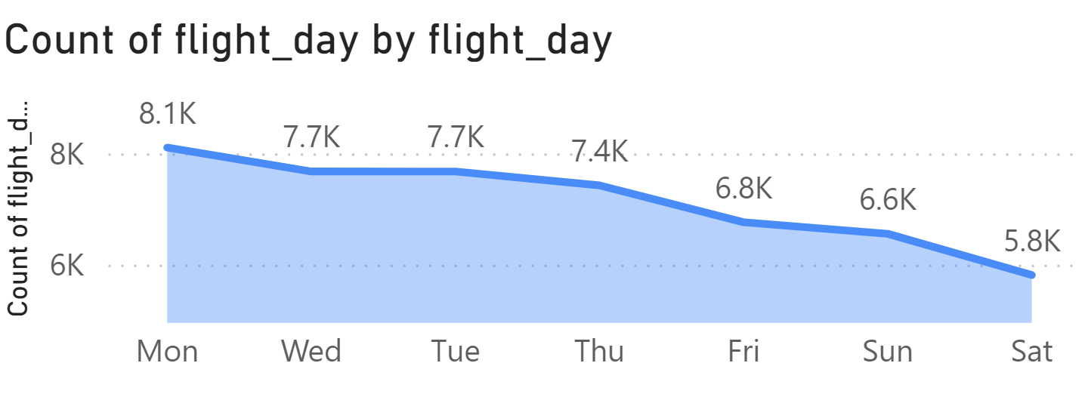
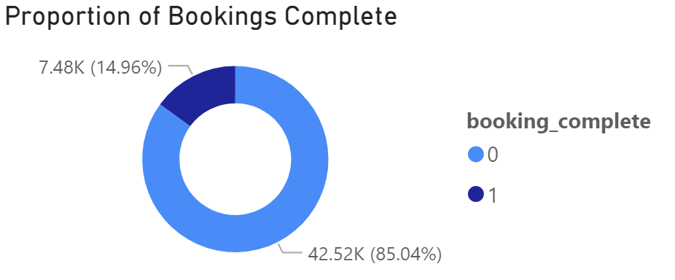
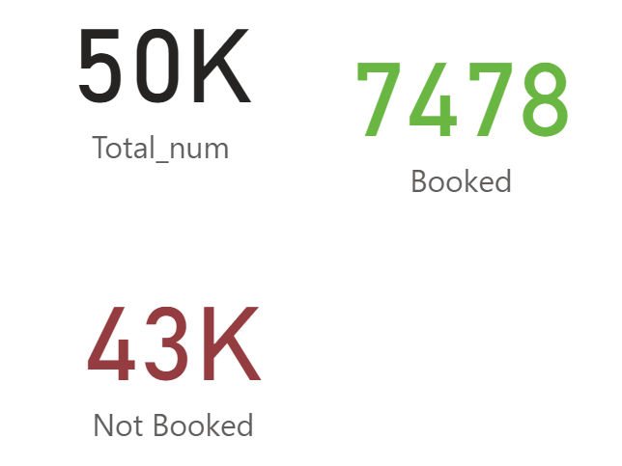
Overview of the Analysis
days
days

Slide 6
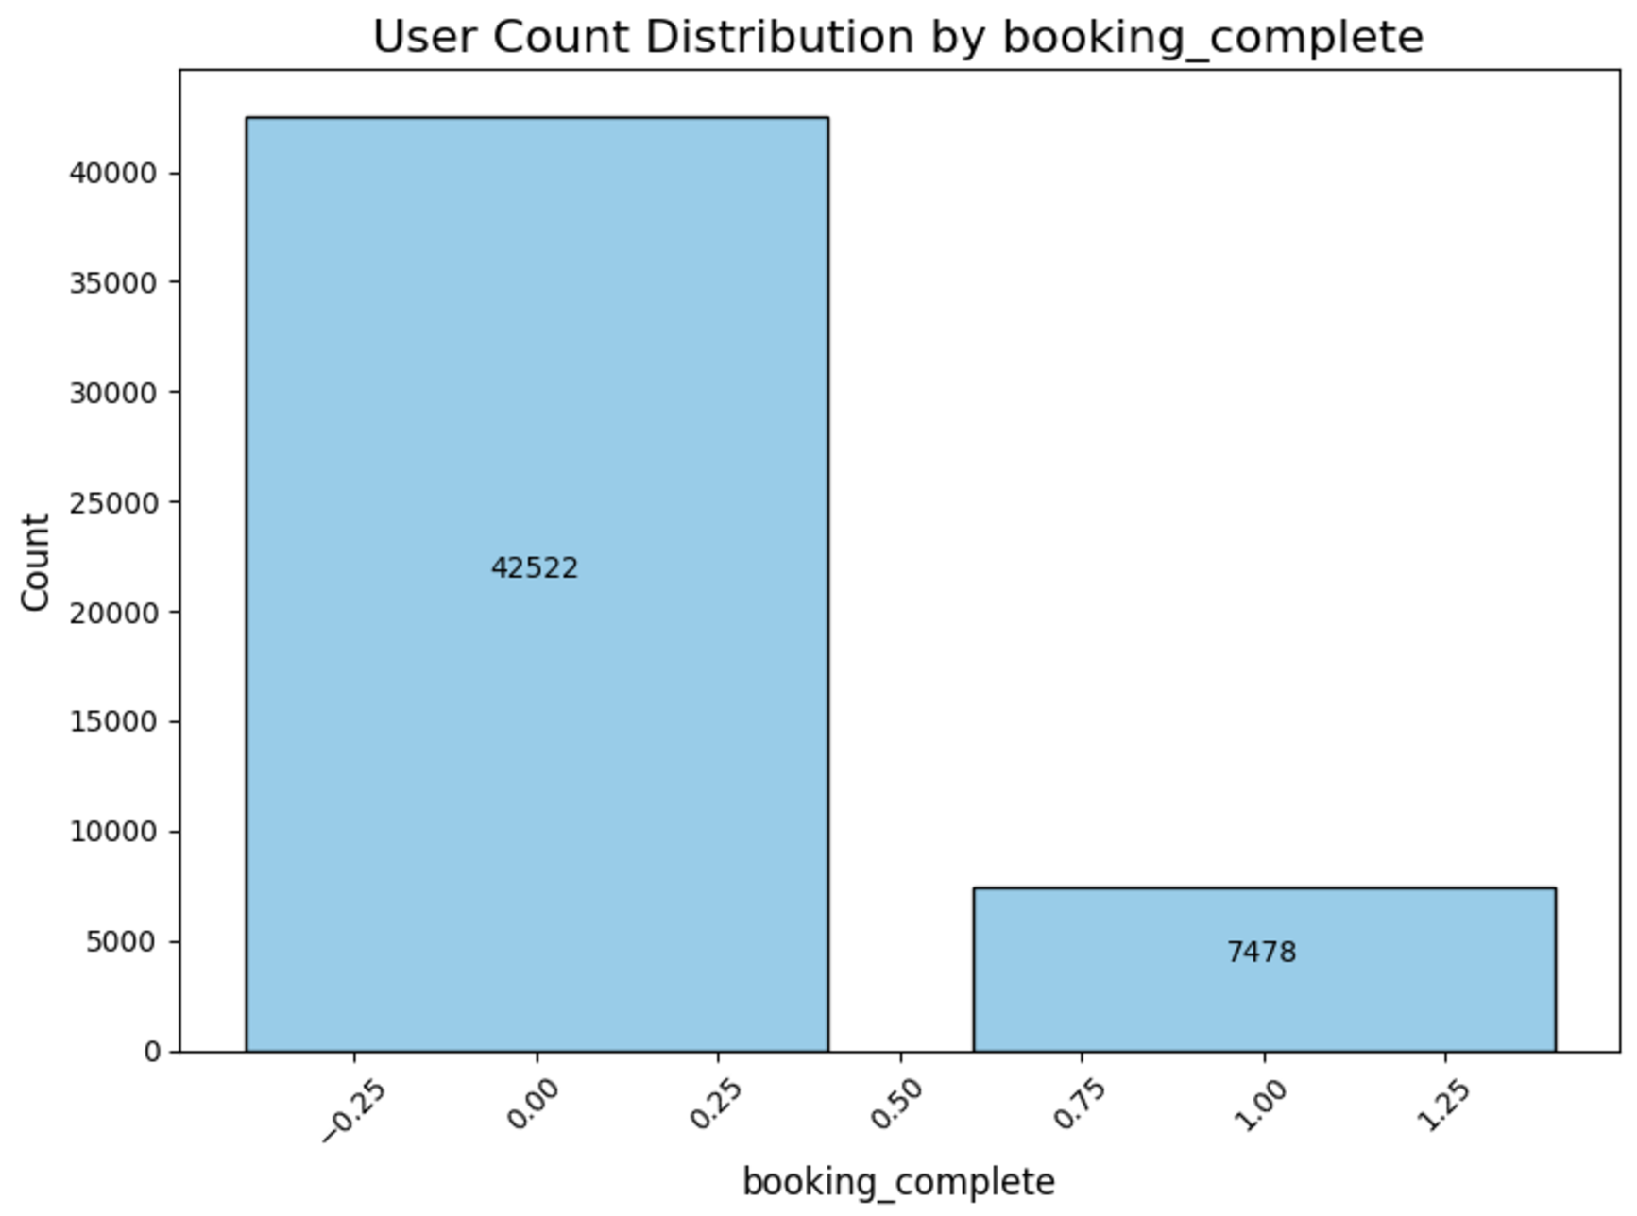
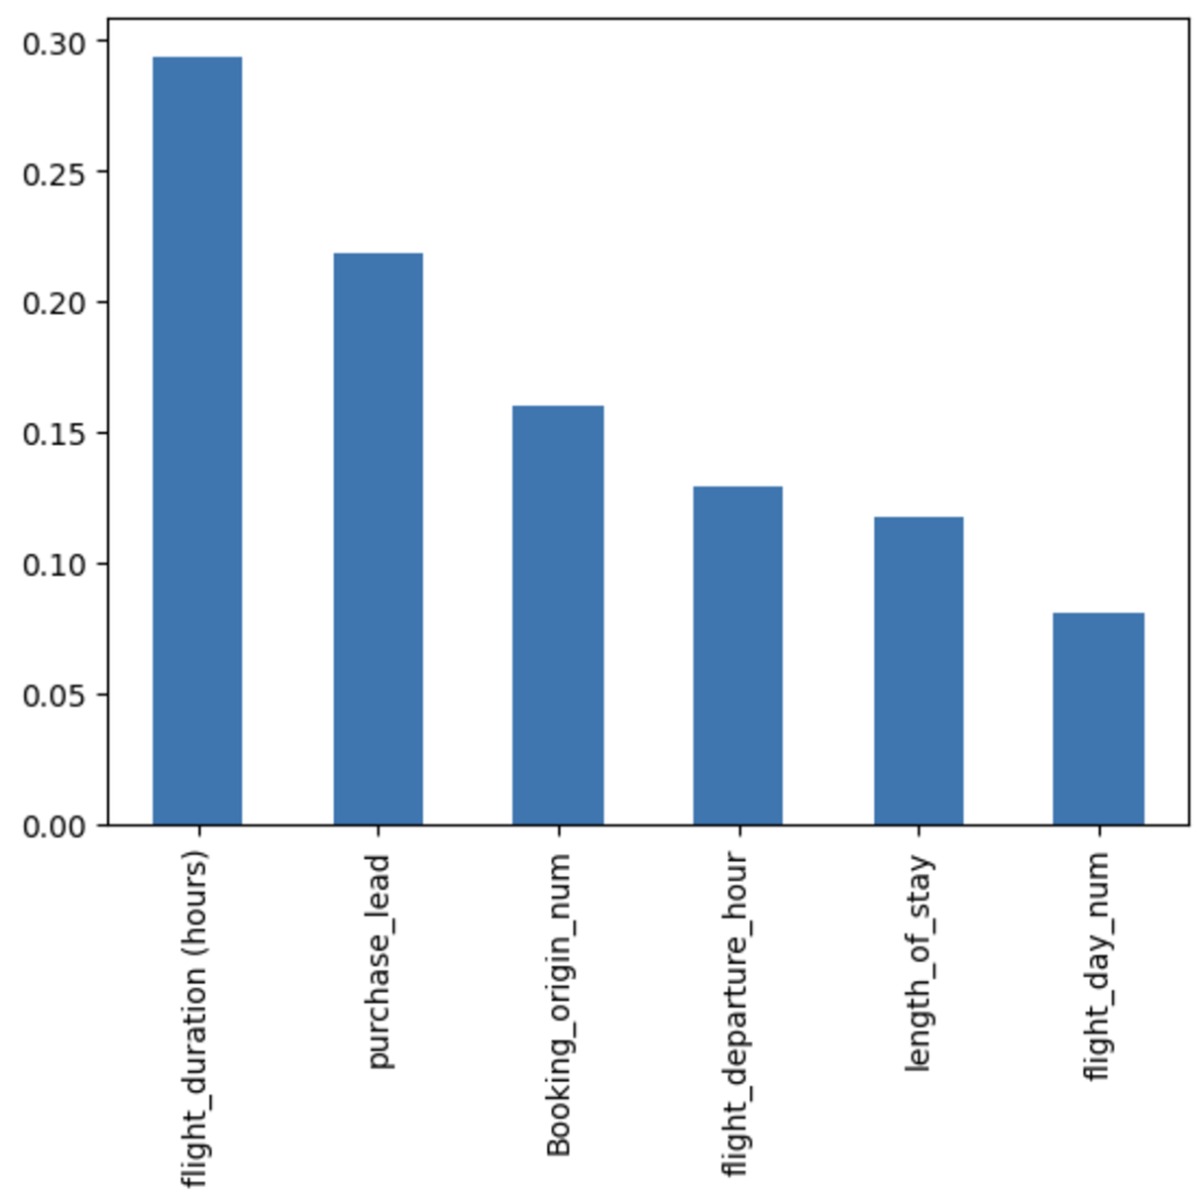
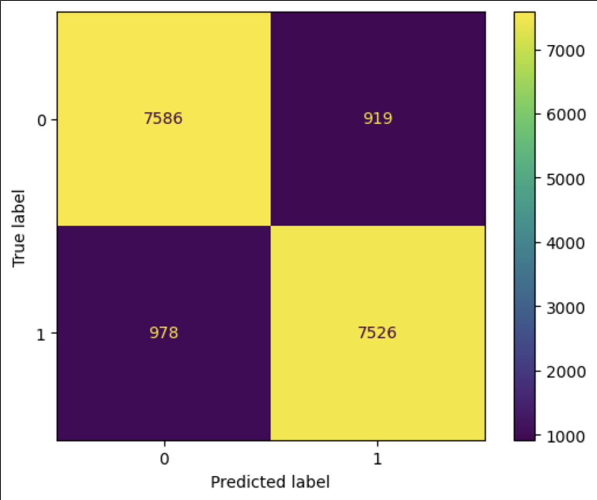
Predictive Modelling – Random Forest
Unbalanced classes
Feature Importance
Model Evaluation
Used SMOTE to balance classes
Split the dataset into 80:20 train test ratio.
Set a random state of 42 and applied stratification while splitting.
Evaluation metrics used:
Accuracy: 88.84%
Precision: 89.12%
Recall: 88.50%
F1-Score: 88.81%
Checked the correlation of features with the target column using a correlation matrix. The above figure shows the influencing features.

